Slide 1
PROJECT TWO
Exploratory Data Analysis (EDA)

Slide 2
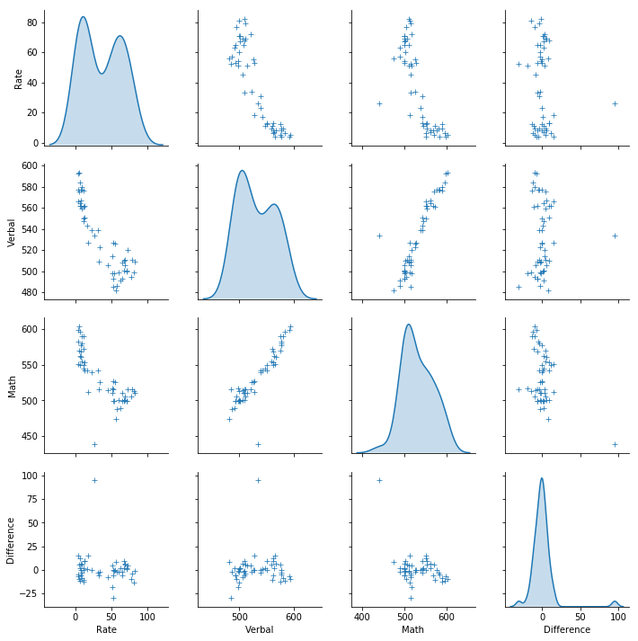
3.2 Using seaborn's pairplot, show the joint distributions for each of Rate, Math, and Verbal

Slide 3
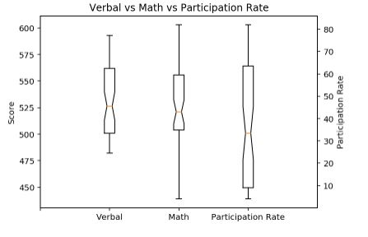
4.3 Plot Verbal, Math, and Rate appropriately on the same boxplot chart

Slide 4
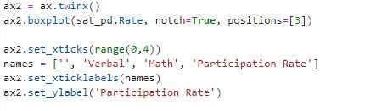
4.3 Plot Verbal, Math, and Rate appropriately on the same boxplot chart

Slide 5
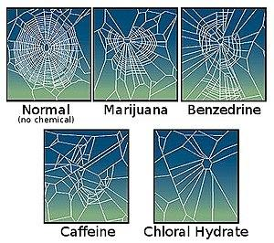
7.3 Create a testable hypothesis about this data

Slide 6

7.3 Create a testable hypothesis about this data

Slide 7

7.3 Create a testable hypothesis about this data

Slide 8
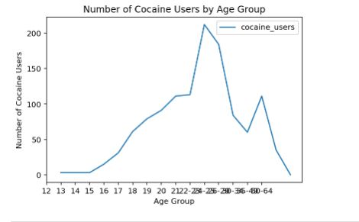
7.3 Create a testable hypothesis about this data

Slide 9

7.3 Create a testable hypothesis about this data

